Slide 1


Git Transactions: From Local to Remote and Back
Welcome to an in-depth guide on Git transactions! This presentation will demystify the essential commands for managing your code efficiently between local and remote repositories. Master these fundamental operations to streamline your development workflow and enhance team collaboration.
Notes:
1

Slide 2



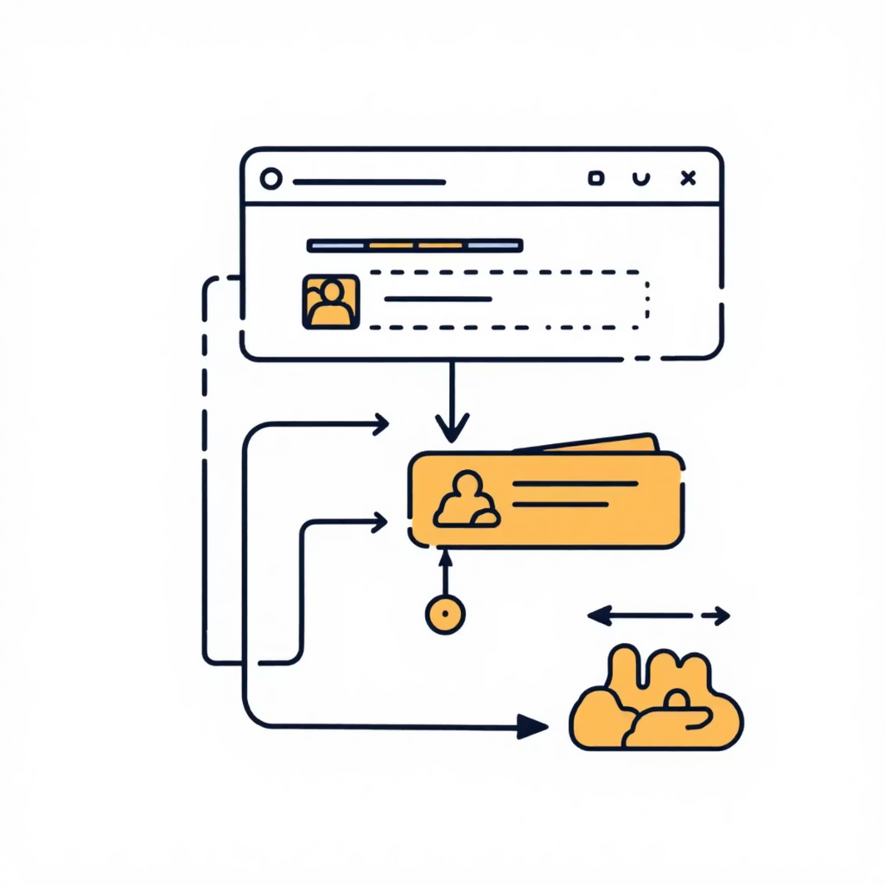
Starting Your Git Journey: `git init` & `git add`
Setting Up Your Local Repository
Preparing Changes for Commit
git init
git add
This command transforms your current directory into a new Git repository. It creates a hidden .git subdirectory, initialising all necessary Git files and structures to track changes in your project.
Use `git add` to stage specific files or directories for your next commit. Staging means telling Git which changes you want to include in the upcoming snapshot. For example, git add . stages all new and modified files in the current directory.
Notes:
2

Slide 3

Saving Your Work Locally: `git commit -m "message"`
The Core of Version Control
Descriptive Messages Are Key
A commit is a snapshot of your repository at a specific point in time. It's like saving a milestone in your project's history. Each commit needs a clear, concise message explaining the changes made.
Using git commit -m "Your descriptive message here" creates this snapshot. A good message helps you and your team understand the purpose of the changes without having to inspect the code itself.
Building a Local History
Commits are stored locally, forming a timeline of your project's development. This history is invaluable for tracking progress, reverting changes, or understanding how features evolved.
Notes:
3

Slide 4


Connecting to the Remote: `git remote` & `git push`
Managing Remote Repositories
Remote repositories, such as those hosted on GitHub, GitLab, or Bitbucket, provide a centralised location for your project. They enable collaboration and provide a backup of your work.
git remote -v
This command lists all configured remote repositories for your local Git project, showing their shortnames (e.g., origin) and their corresponding URLs. origin is the default name given to the server where your repository was initially cloned from or published to.
git push origin main
Once you've made local commits, this command uploads them to the specified remote repository (origin) and branch (main). It effectively shares your local changes with the rest of the team and updates the online version of your project.
Notes:
4

Slide 5
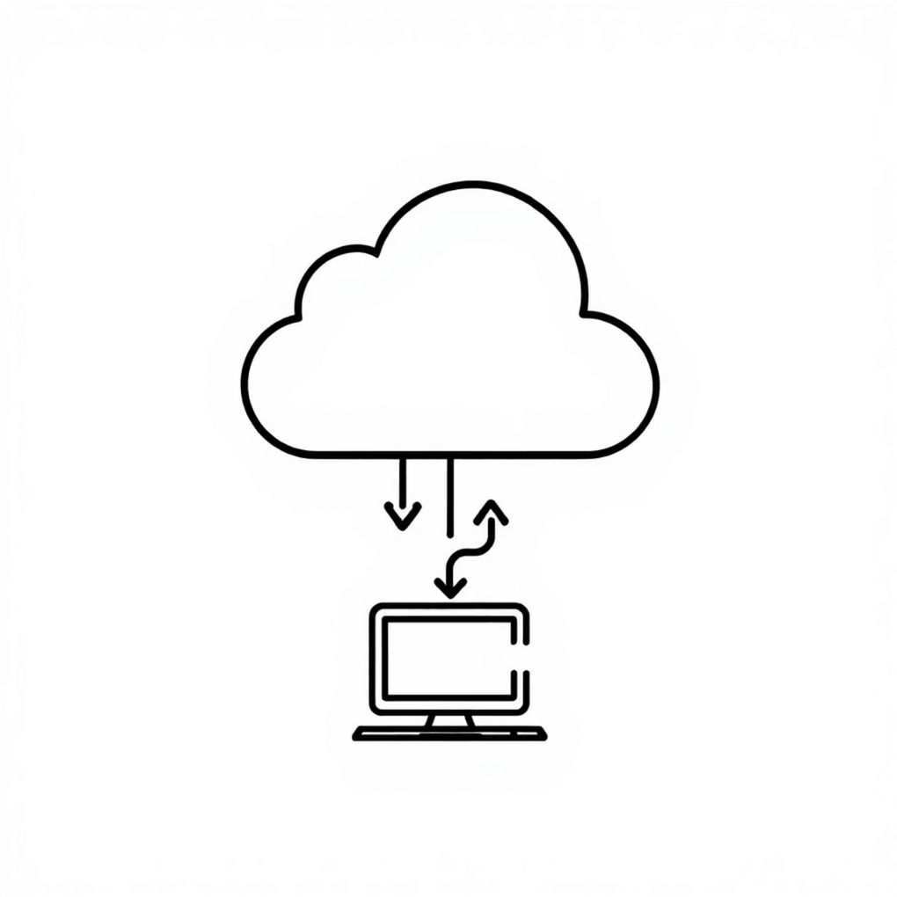
Keeping Your Local Repo Updated: `git pull`
Synchronising with Remote Changes
Staying up-to-date with your team's progress is crucial. The git pull command is your primary tool for fetching and integrating updates from the remote repository into your local branch.
git pull origin main
This command executes two key operations: first, it runs git fetch to download the latest changes from the main branch of the origin remote; then, it performs a git merge to integrate those fetched changes into your current local branch.
Preventing Conflicts
Regularly pulling ensures your local codebase is aligned with the remote, significantly reducing the likelihood of merge conflicts when you push your own changes. It helps maintain a coherent and collaborative development environment.
Notes:
5

Slide 6



Branching Out: `git branch` & `git checkout`
Why Use Branches?
git checkout
git branch
Branches are fundamental for non-linear development. They enable multiple developers to work on different features simultaneously, integrate changes safely, and manage releases effectively, making them indispensable for team-based projects.
After creating a branch, git checkout <branch-name> allows you to switch your working directory to that specific branch. This command updates your files to reflect the state of the chosen branch, enabling focused development without affecting other branches.
Branches are powerful tools in Git, allowing you to develop new features, fix bugs, or experiment with ideas in isolation from the main codebase. Use git branch to list existing branches or git branch <new-branch-name> to create a new one.
Notes:
6

Slide 7



Merging Changes: `git merge`
Bringing Work Together
Once a feature or fix developed on a separate branch is complete and tested, git merge is used to integrate those changes back into a target branch, typically main or develop.
Seamless Integration
First, switch to the target branch you want to merge into: git checkout main. Then, merge the completed branch: git merge feature-x. Git will attempt to combine the histories automatically.
Conflict Resolution
If conflicts arise (when the same lines of code are changed differently in both branches), Git will pause the merge and prompt you to resolve them manually. Tools are available to assist in navigating and resolving these discrepancies, ensuring a clean integration.
Notes:
7

Slide 8



Cleaning Up: `git push origin --delete branch-name`
Removing Obsolete Remote Branches
git push origin --delete feature-x
Maintaining Repository Hygiene
After a feature branch has been successfully merged and its changes are integrated into the main codebase, the branch itself may no longer be necessary. Deleting remote branches keeps your repository streamlined and organised.
This command specifically targets and removes the specified branch (e.g., feature-x) from your origin remote repository. This action only deletes the remote reference; your local branch remains intact until you manually delete it with git branch -d feature-x.
Regularly cleaning up merged or abandoned branches prevents clutter in your remote repository's branch list, making it easier for developers to navigate and focus on active development branches.
Notes:
8

Slide 9
Typical Workflow Summary
01
02
03
Initialise & Stage
Commit Locally
Connect Remote
Start with git init to create a new repository. Then, prepare your files for commit using git add .
Save your changes with a meaningful message: git commit -m "Meaningful message".
Link your local repository to a remote server: git remote add origin <URL>.
04
05
06
Push to Remote
Pull for Updates
Branch & Merge
Upload your local commits to the remote branch: git push origin main.
Fetch and merge remote changes into your local branch: git pull origin main.
Create isolated development lines with git branch and git checkout. Integrate them using git merge.
07
Clean Up Remotes
Remove merged or obsolete remote branches: git push origin --delete <branch-name>.
Notes:
9

